Slide 1
The Impact of Open Futures
End of KS2 Results: 3 Year Trend
Percentage of pupils achieving Level 4 or above at the end of Key Stage 2.
 | 2012 | 2013 | 2014
 | Level 4+ | Level 4+ | Level 4+
Reading | 75 | 79 | 94
Writing | 68 | 63 | 77
SPAG |  | 65 | 68
Maths | 76 | 79 | 87
R/W/M combined | 63 | 66 | 68

Slide 5
Fitting the Four Strands into a crowded curriculum
5 | To investigate the properties of materials Give reasons, based on evidence from comparative and fair tests, for the particular uses of everyday materials, including metals, wood and plastic. To work scientifically. Plan enquiries, including recognising and controlling variables where necessary. | Children to apply the knowledge gained in previous lessons to solve a problem. Which materials would be the most effective for making a warm jacket/ keeping somebody warm/ for stopping ice melting/ for making blackout curtains?
6 | To work scientifically Present findings in written form, displays and other presentations. | Children to observe the changes that are made when baking bread/ cakes. COOK IT afternoon discussion the different process that take place. TO BE ARRANGED WITH K. SCOTT TO TAKE HALF THE CLASS.

Slide 6
Medium Term Plan
Topic: What different ways can you move objects? : Science: Forces Year Group: 3 Date: Summer Term 1
1 WALT: know forces act on objects Can I say what a force is? Can I name somewhere I amy see a force? Can I decide if this is a push or a pull force? Can I start to see if pushes or pulls can be affected by other variables? | Think of 3 or 4 examples of places where you might find forces in action and write them on the IWB e.g. the classroom, the park, a school playground, the seaside. Can children suggest forces that they might see being applied, e.g. opening & closing a door or a drawer, pulling someone back & then pushing them on a swing, kicking a football, throwing a ball, building a sandcastle, etc. Point out that all of these forces require contact between two objects (one of which may be a person or an animal!). Explain that scientists show where & in what direction a force is acting by using arrows. Draw a diagram of a door being opened & indicate the pulling force with an arrow. Ask what force will be applied to close the door? Show children the diagram of a boy kicking a ball & ask a volunteer to show the force using an arrow (some children may point out that gravity/air resistance is also acting on the ball – if so, agree & explain that they will find out more about this in Y5). 3 Activities Activity 1 Weather permitting! Take ch outside to experiment with forces on a ball-does it matter how they move it? Will it always travel as far? Why? why not? How can they make it travel further? Why do they think this is? Ch to draw what they have found when throwing, bouncing and rolling the ball. TEACHER Activity 2 Ch to draw pictures of scenes we have looked at with pushes and pulls-using arrows ch to draw where the forces are evident. (templates provided for LA) INDP Activity 3 GROW IT-with TA support-ch to work on planting seeds and pulling out weeds-ch to observe the pushes and pulls that take place? Why were certain weeds harder to pull? What affected this?

Slide 7
Philosophical Inquiry Session Planner- PHCSE -Selfishness
Date: 20.04.15 | Time: 14:00-15:00 | Group: Y6
Inquiry element Activity Skills | ACTIVITY | SKILLS
Introduction | Recap rules for P4C, participation, thumbs up, respect opinion of others. | Listening
Warm-ups | I wonder why… children to volunteer what they wonder about. Other children may answer in one sentence only. | Connecting concepts.
Grouping | Working in pairs after watching stimulus. | Working with new partners, collaborative thinking.
Stimulus | Excerpt from Oliver Twist – Food Glorious Food. | Concept focus, private thinking.
Question making | 2 per pair. >> 1 question per group of 4 | Creative thinking, negotiation, evaluation.
Question airing | Questions appreciation, open questions? Closed questions? | Critical thinking, evaluation.
Question choosing | Open ‘omnivote’. Lay questions on the floor and vote with feet. | Choosing, evaluation
Dialogue | Focus on building, following on. | Caring, thinking, memory, connecting concepts.
Last words | Pass Sully. | Reflection, listening, turn-taking.
Process reflection | Examples of good listening, values of good listening. | Evaluation.
NOTES Retrospective: Children choose question, ‘Why are humans selfish?’ Dialogue included looking at scale of selfishness, are all selfish acts bad? Which ones are good? Led to whether selfishness is inherent. Then nature v nurture. Children then began to discuss current political agenda leading to the question; ‘do wealthy people have a moral obligation to look after (give money to) poorer people? Excellent topical discussion. Surprisingly 80% children were dispassionate and seemingly lacking empathy. They overwhelmingly felt that the position poor people find themselves in is of their own fault. However, this mode of thinking could easily be interpreted as having an industrious nature!

Slide 8
What pupils say about Open Futures …
It gets you more involved, you get messy and you get to choose more.
My Granddad applied to do the allotment and now I can help him.
We get to make things I didn’t know about and also get to do things I’m not allowed to do at home … we made potato salad, I hadn’t heard of that before.
You can take it home and show your family and then do it at home.
We filmed each other when we were learning about the Vikings, then I filmed my sister at home.
I like askit because you get information but it’s confusing.

Slide 9
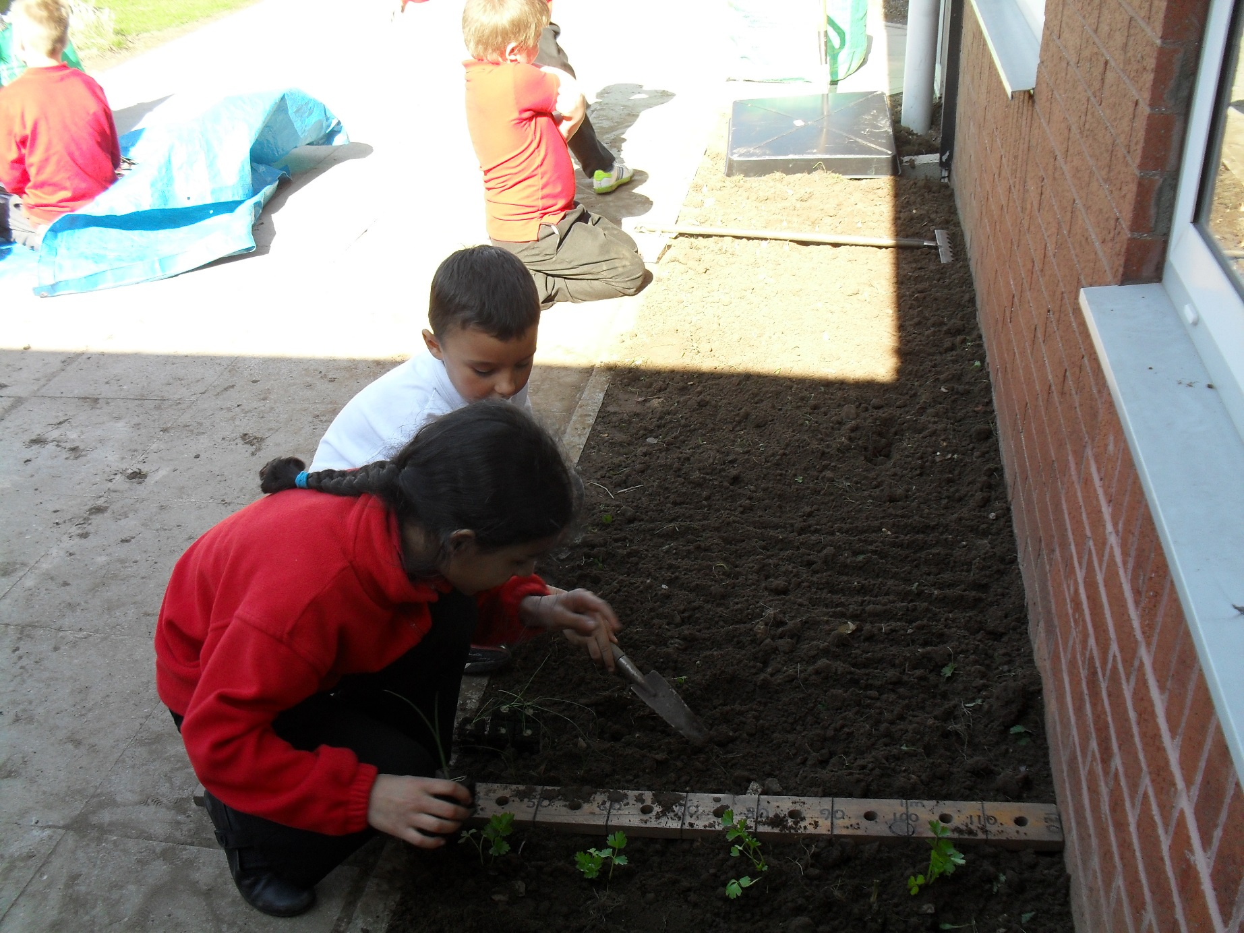

Slide 10
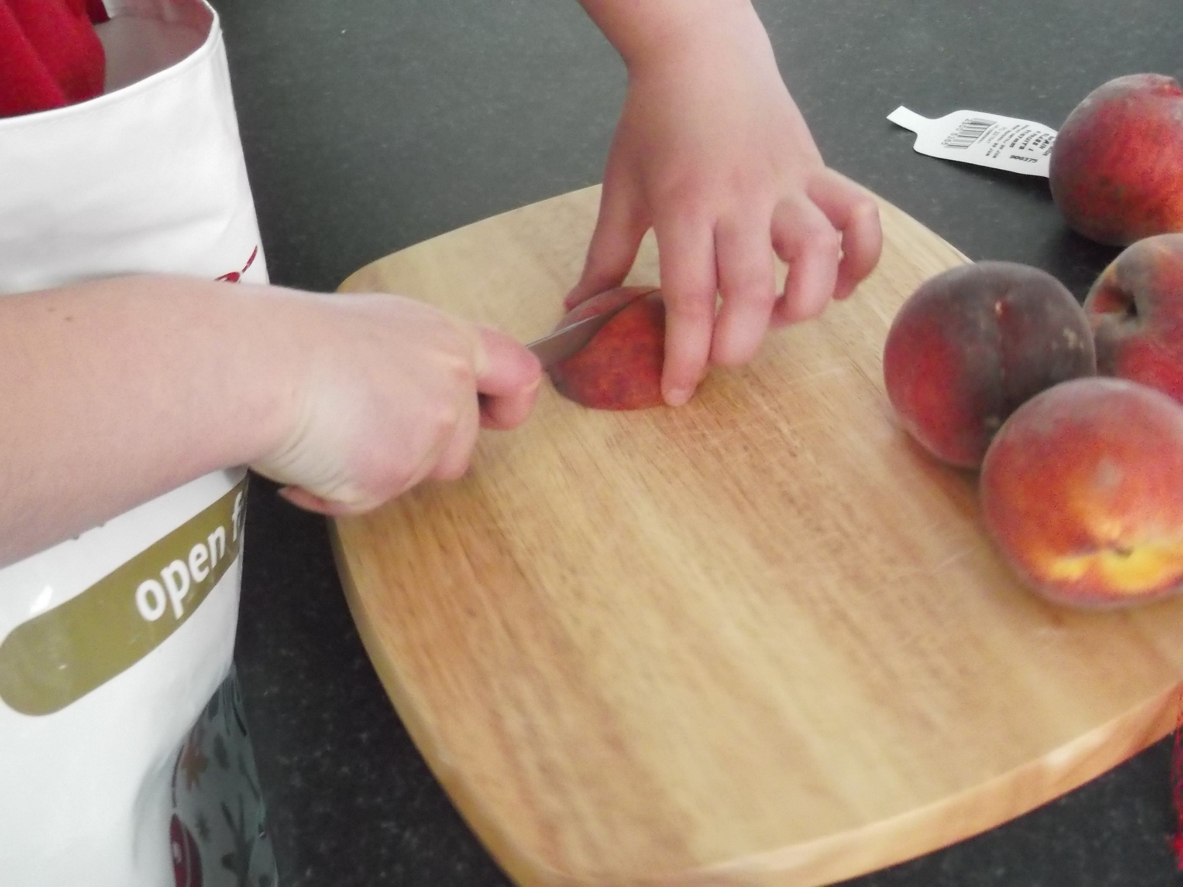

Slide 11
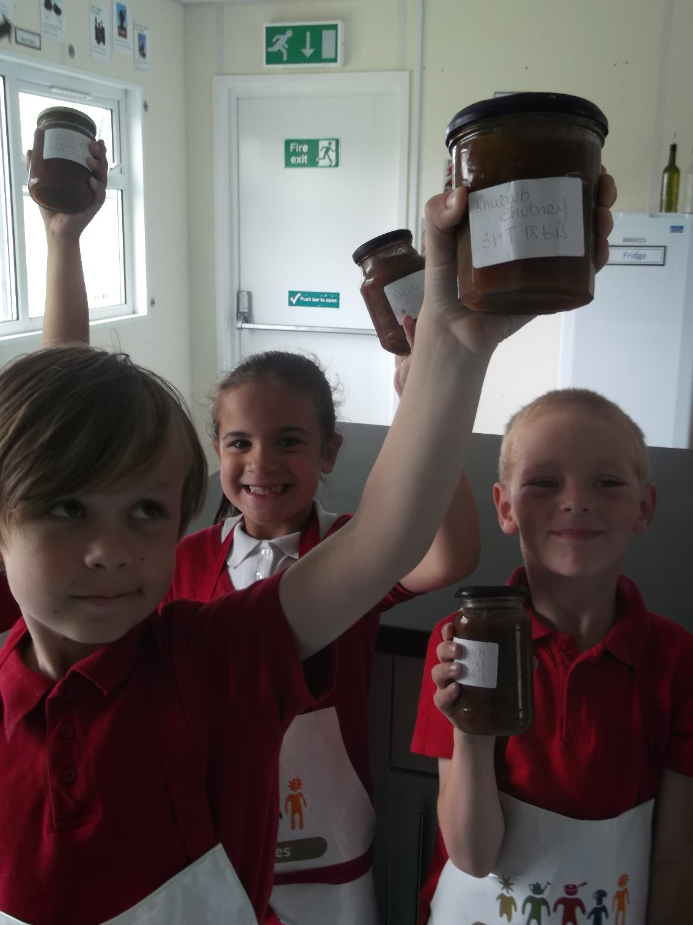

Slide 12
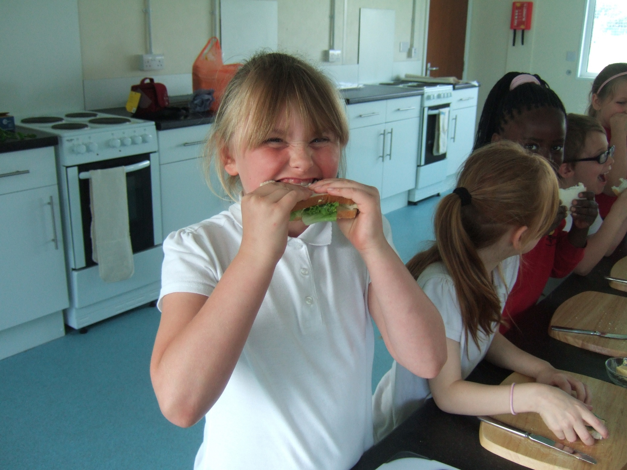

Slide 13
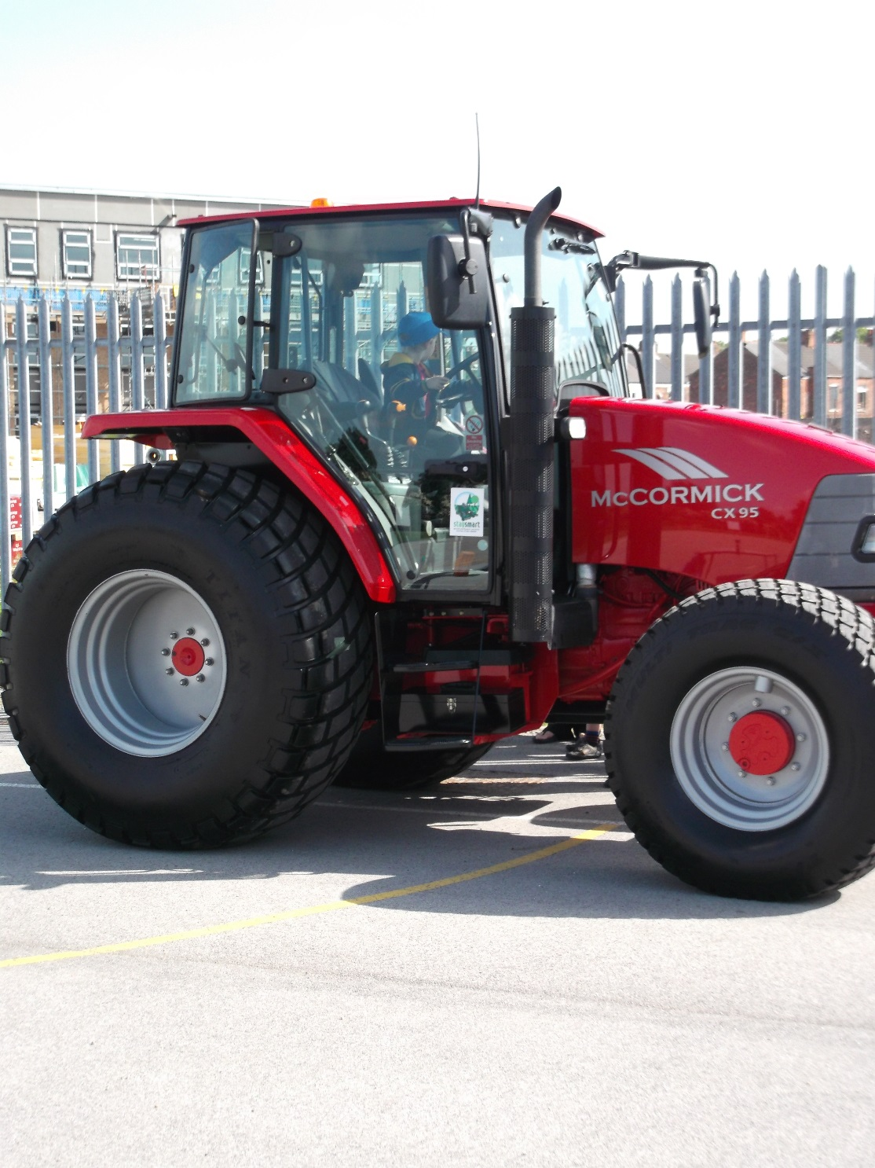

Slide 14
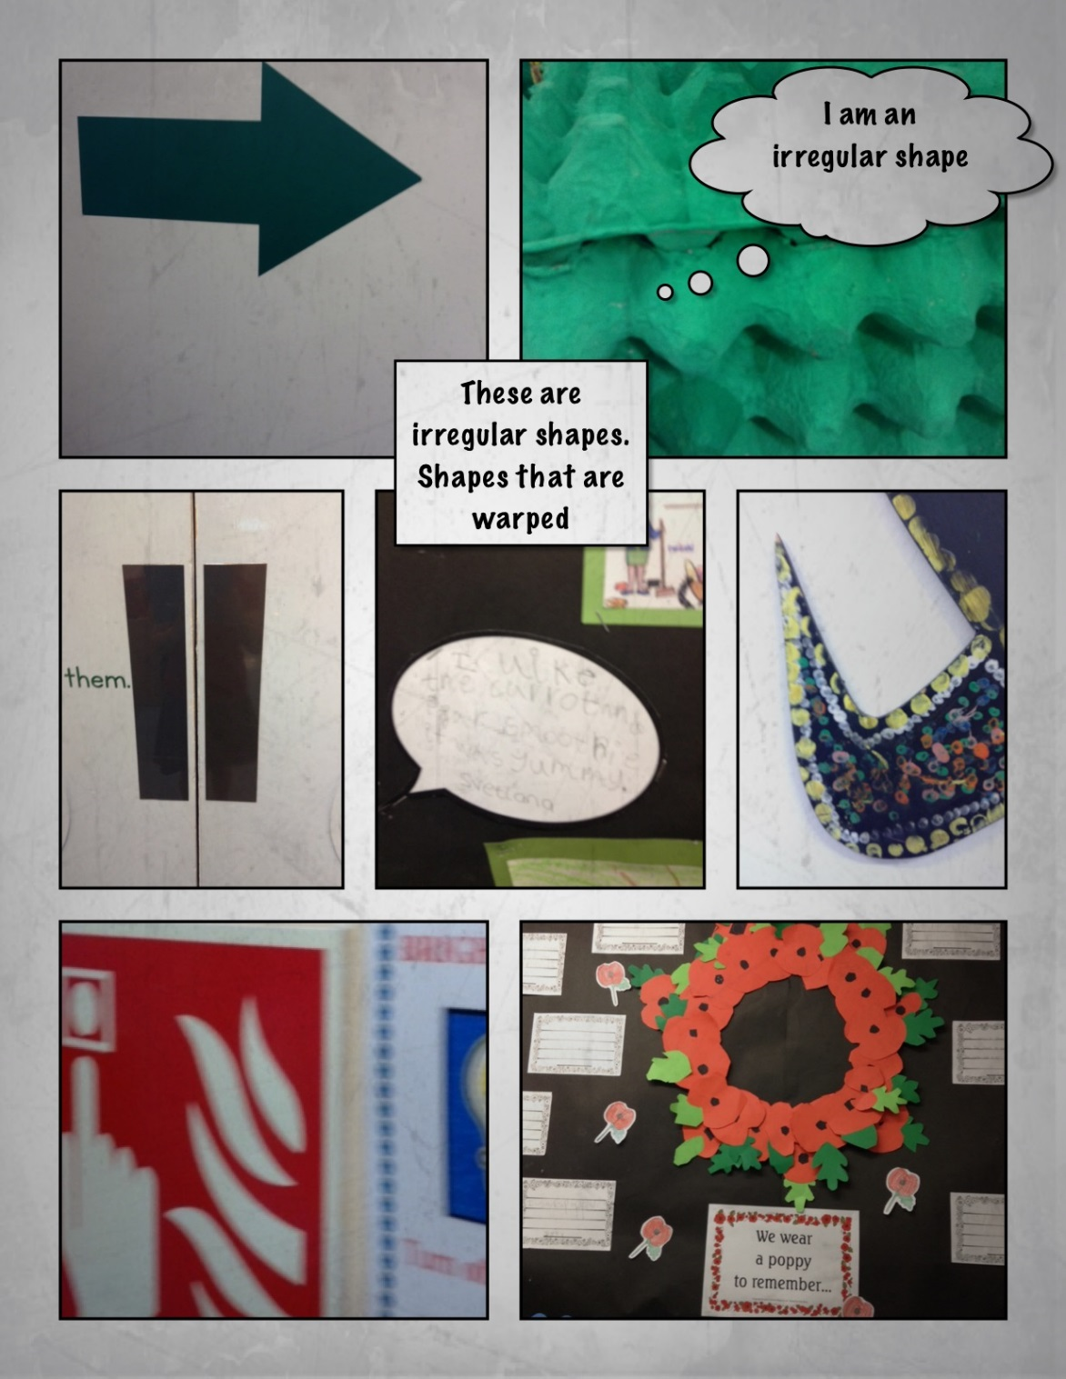

Slide 15
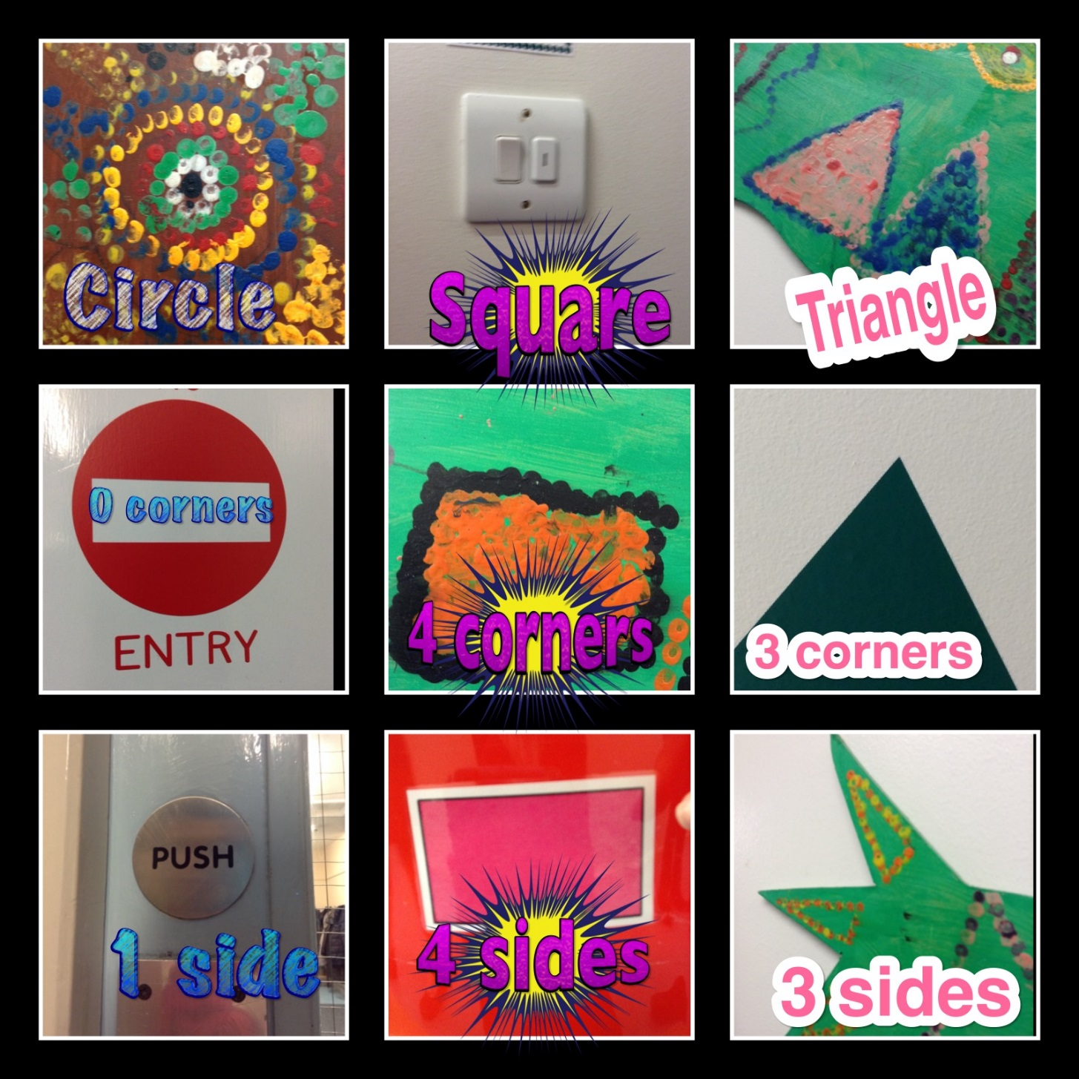

Slide 16
